Slide 1
GROWING DEMAND FOR VIDEO [30]:
Video exceeds half of internet traffic and will grow to 86 percent by 2016 [30].
Increase in applications, content, fidelity, etc. -Need higher coding efficiency! [30].
Ultra-HD 4K broadcast expected for Japan in 2014. London Olympics Opening and Closing Ceremonies shot in Ultra-HD 8K. - Need higher throughput! [30].
25x increase in mobile data traffic over next five years. Video is a “must have” on portable devices. - Need lower power! [30].

Slide 2
H.264/MPEG-4 [2][9]:
H.264/Advanced Video Coding (AVC) is video coding standard of the ITU-T Video Coding Experts Group and the ISO/IEC Moving Picture Experts Group [2].
Most popular video standard- 80% of video is encoded on internet with H.264/AVC [9].
Developed for multimedia applications [9].
Adopted advanced coding techniques such as multiple-reference frame prediction, and context-based adaptive binary arithmetic coding (CABAC).

Slide 3
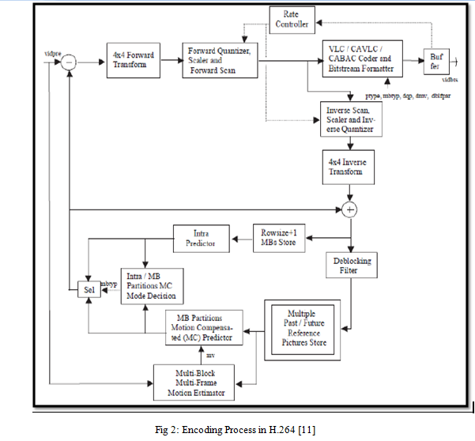
ENCODER IN H.264 [11]:

Slide 4
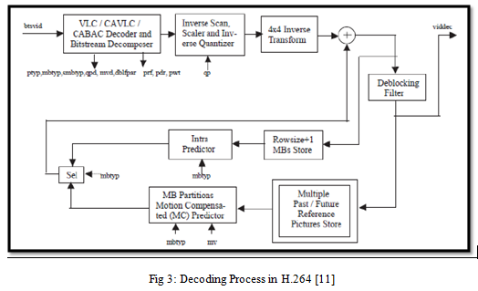
DECODER IN H.264 [11]:

Slide 5
FEATURES OF H.264:
Prediction [12]:
Fig 4: Intra prediction in H.264 [12]
Fig 5: Inter prediction in H.264 [12]

Slide 6
FEATURES OF H.264(cotd..):
Transform and Quantization [13]:
A block of residual samples is transformed using a 4x4 or 8x8 integer transform, an approximate form of the Discrete Cosine Transform (DCT) . The transform outputs a set of coefficients, each of which is a weighting value for a standard basis pattern. The output of the transform, a block of transform coefficients, is quantized, i.e. each coefficient is divided by an integer value .
Entropy Coding [15]:
H.264 uses CABAC(Context Adaptive Binary Arithmetic Coding )
or CAVLC(Context Adaptive Variable Length Coding) for entropy coding[14].

Slide 7
HEVC/H.265 [1]:
High Efficiency Video Coding (HEVC) is an international standard for video compression developed by a working group of ISO/IEC MPEG (Moving Picture Experts Group) and ITU-T VCEG (Visual Coding Experts Group).
High Efficiency Video Coding (HEVC) is the latest Video Coding format .
It challenges the state-of-the-art H.264/AVC Video Coding standard which is in current use in the industry by being able to reduce the bit rate by 50% and retaining the same video quality [1].

Slide 8
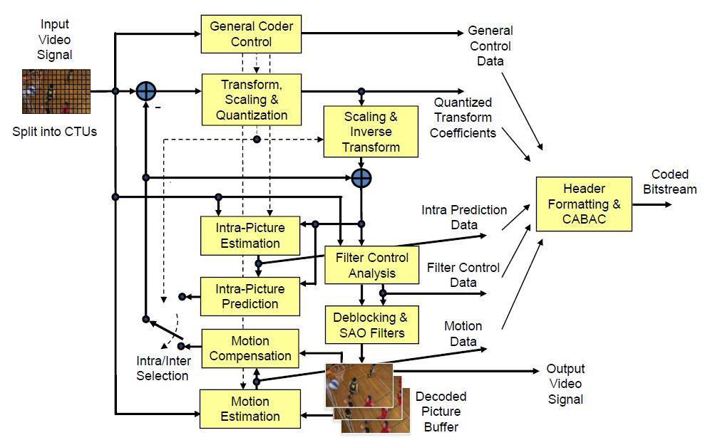
Encoder in H.265 [19][20]:
Fig 6 : Block Diagram of HEVC Encoder [17]

Slide 9
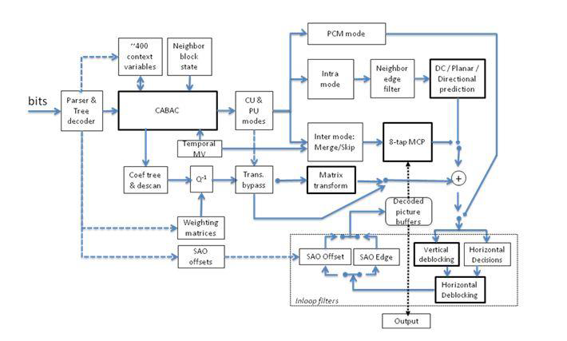
DECODER IN H.265 [19][21]:
Fig 7 : Block Diagram of HEVC Decoder [21]

Slide 10
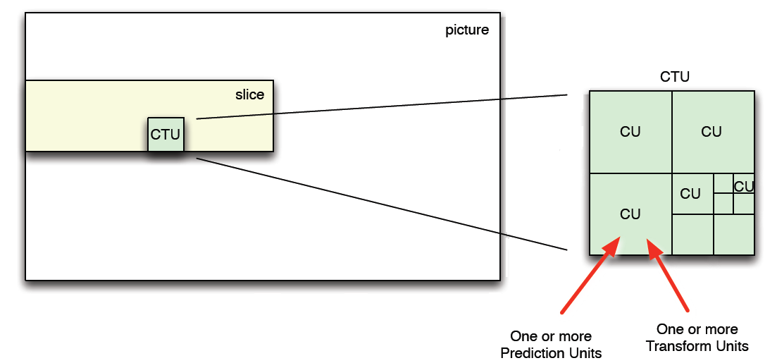
FEATURES OF HEVC:
Partitioning [19]:
Fig 8: Picture, Slice, Coding Tree Unit (CTU), Coding Unit (CU) [19]

Slide 11
FEATURES OF HEVC(cotd..):
Prediction [1] :
- Intra prediction: Each CU is predicted from neighboring image data in the same picture, using DC prediction, planar prediction or directional prediction.
Inter Prediction :Each PU is predicted from image data in one or two reference pictures, using motion compensated prediction.
Transform and Quantization [19]:
Any residual data remaining after prediction, is transformed using a block transform based on the Discrete Cosine Transform (DCT). The transformed data is quantized. One or more block transforms of size 32x32, 16x16, 8x8 and 4x4 are applied to residual data in each CU.
Entropy Coding:
- HEVC uses Context Adaptive Binary Arithmetic Coding (CABAC) [14] for Entropy coding.

Slide 12
Vp9 [3][4]:
VP9 is an open and royalty free video compression standard being developed by Google
VP9 is a successor to VP8.
One of the goals of VP9 is to reduce the bit rate by 50% compared to VP8 while having the same video quality [22].
VP9 has many design improvements compared to VP8.
VP9 supports the use of superblocks of 64x64 pixels.

Slide 13
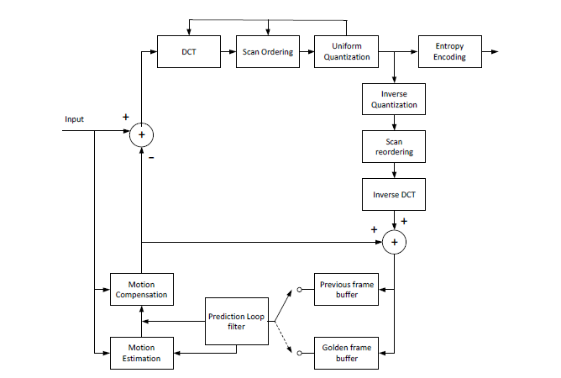
ENCODER INVP9 [24]:
Fig 9: Encoder block diagram for VP9 [24]

Slide 14
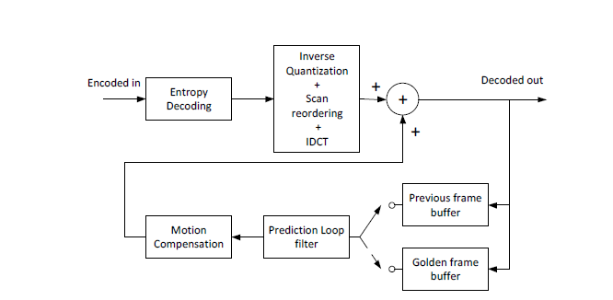
DECODER IN VP9 [24]:
Fig 10: Decoder block diagram for VP9 [24]

Slide 15
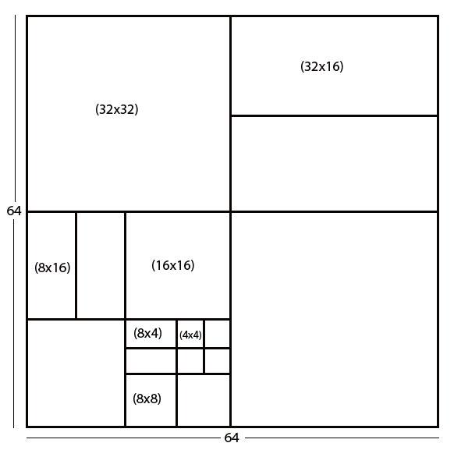
FEATURES OF VP9:
Prediction block sizes [4] [23]:
Fig 11: Example partitioning of a 64x64 Super-block [4] [23]

Slide 16
FEATURES OF VP9(cotd..)
Prediction [4]:
- Intra Prediction : VP9 supports a set of 10 Intra prediction modes for block sizes ranging from 4x4 up to 32x32
- Inter Prediction : VP9 supports a set of 4 inter prediction modes for block sizes ranging from 4x4 up to 64x64 pixels
Transform and Quantization [4]:
The residuals after subtraction of predicted pixel values are subjected to transformation and quantization . Transform blocks can be 32x32, 16x16, 8x8 or 4x4 pixels.
Entropy coding [4]:
- VP9 uses 8-bit arithmetic coding engine from VP8 known as bool-coder

Slide 17
COMPARISON METRICS:
Peak Signal to Noise Ratio (PSNR) [25]
Structural Similarity Index (SSIM) [5][20][31]
BD-Bitrate and BD-PSNR [6]
Computational time as a measure of implementation complexity

Slide 18
Results :
Implementation results for akiyo_qcif.yuv , Number of Frames Encoded = 20
 | HEVC |  |  | H.264 |  |  | VP9
QP | PSNR in dB | Bit Rate in Kbps | Encoding time in seconds | PSNR in dB | Bit Rate in Kbps | Encoding time in seconds | PSNR in dB | Bit Rate in Kbps | Encoding time in seconds
22 | 44.6421 | 369.4440 | 5.836 | 44.4821 | 474.04 | 1.394 | 42.804 | 287.634 | 4.118
27 | 41.0097 | 243.0660 | 5.195 | 40.6602 | 299.65 | 1.111 | 40.946 | 231.692 | 3.850
32 | 37.5213 | 154.0740 | 4.732 | 36.7820 | 188.64 | 0.998 | 39.110 | 185.502 | 3.543
37 | 34.1119 | 93.1920 | 4.257 | 34.0513 | 119.56 | 0.994 | 37.217 | 145.822 | 3.402
Table 1 : Implementation results for akiyo_qcif.yuv sequence

Slide 19
Results(cotd..)
Fig 17: R-D Plot for akiyo_qcif.yuv sequence

Slide 20
Results(cotd..)
Fig 18: R-D Plot for waterfall_cif.yuv sequence

Slide 21
Results(cotd..)
Fig 19: R-D Plot for BasketballDrill_832x480_50. yuv sequence

Slide 22
Results(cotd..)
Fig 20: R-D Plot for Jockey_1920x1080. yuv sequence

Slide 23
Results(cotd..)
Fig 21: R-D Plot for PeopleOnStreet_2560_1600_30_crop.yuv sequence

Slide 24
Results(cotd..)
Fig 22: Comparison of encoding time in all-intra configuration for akiyo_qcif.yuv sequence

Slide 25
Results(cotd..)
Fig 23 : Comparison of encoding time in all-intra configuration for waterfall-cif.yuv sequence

Slide 26
Results(cotd..)
Fig 24 : Comparison of encoding time in all-intra configuration for BasketballDrill_832x480_50.yuv sequence

Slide 27
Results(cotd..)
Fig 25 :Comparison of encoding time in all-intra configuration for Jockey_1920x1080.yuv sequence

Slide 28
Results(cotd..)
Fig 26 : Comparison of encoding time in all-intra configuration for PeopleOnStreet_2560_1600_30_crop.yuv sequence

Slide 29
Results(cotd..)
Fig 27: Comparison of HEVC and H.264 based on BD-Bitrate

Slide 30
Results(cotd..)
Fig 28: Comparison of HEVC and VP9 based on BD-Bitrate

Slide 31
Results(cotd..)
Fig 29: Comparison of HEVC and H.264 based on BD-PSNR

Slide 32
Results(cotd..)
Fig 30: Comparison of HEVC and VP9 based on BD-PSNR

Slide 33
CONCLUSIONS
VP9 needs 33.57% more bit rate than HEVC and H.264 needs 47.05% more bit rate than HEVC for the same PSNR.
HEVC has 27% - 40% more encoding time than VP9 and VP9 has 100% more encoding time than H.264.

